Slide 1

DS105 - Final Project Presentation -
Fake News Detection
Au Yuh Jiin

Slide 2

Overview
In our modern era where everyone relies on various online resources for news. Along with the increase in the use of social media platforms, people share the information without verifying it.. Spreading fake news has become a serious issue in the current social media world. The purpose of the work is to come up with a solution that can be utilized by users to detect fake news.

Slide 3

In this project, we are using some machine learning and Natural language processing libraries :-
Word tokenization
Predicting parts of speech for each token
Text lemmatization
Identifying and removing stop words,

Slide 4
Understanding the data

Slide 5
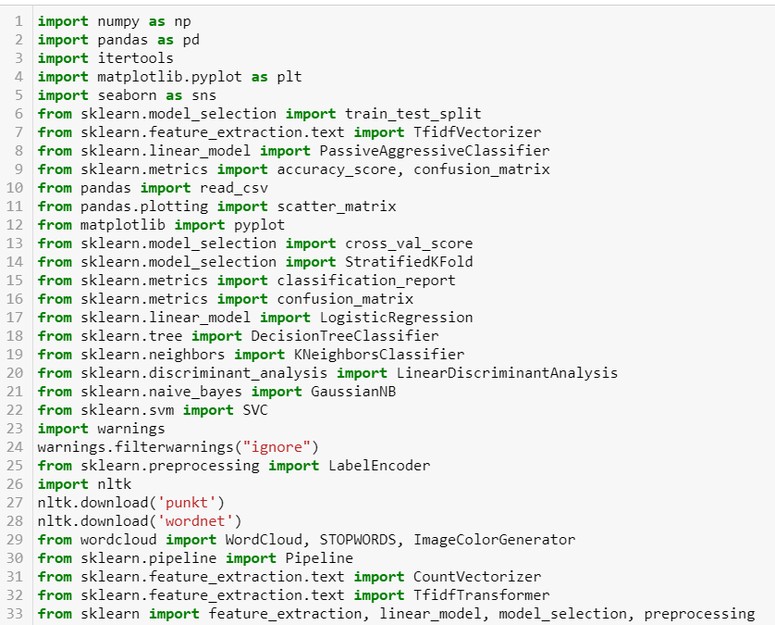
Import libraries

Slide 6
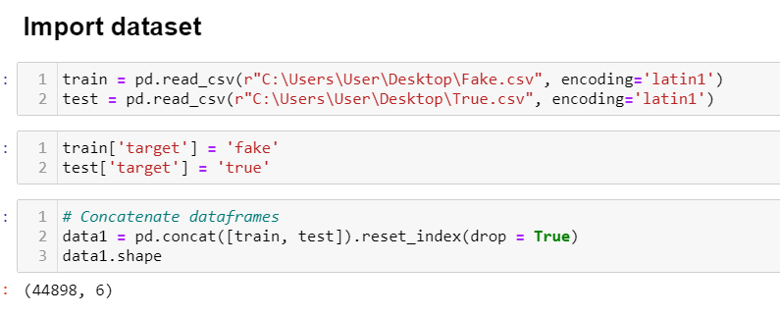
This combined dataset contains 44898 observations and 6 features

Slide 7
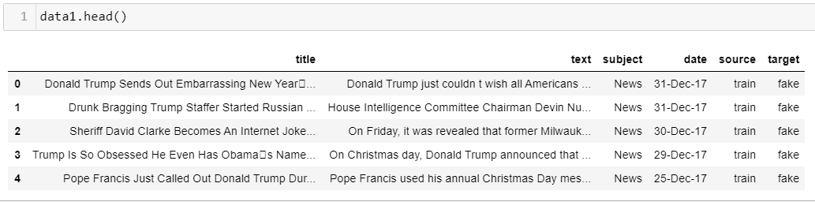
Data Exploration

Slide 8
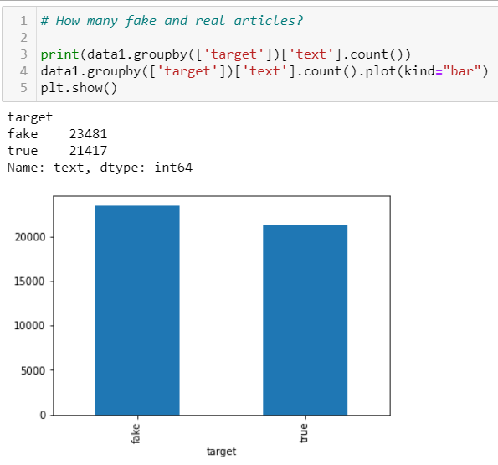
Data Exploration

Slide 9
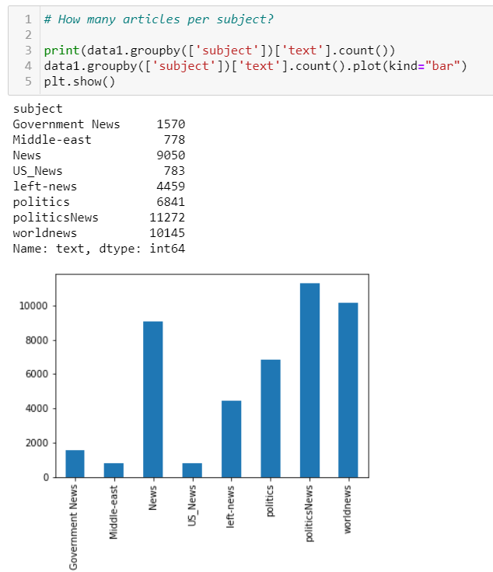
Data Exploration

Slide 10

Data Cleaning

Slide 11
Data Cleaning
Word tokenization - We use the method word_tokenize() to split a sentence into words. The output of word tokenization can be converted to Data Frame for better text understanding in machine learning applications. It can also be provided as input for further text cleaning steps such as punctuation removal, numeric character removal or stemming. Machine learning models need numeric data to be trained and make a prediction.
1

Slide 12
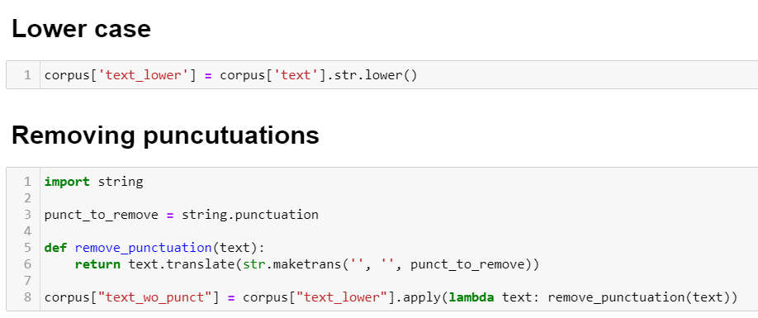
Data Cleaning

Slide 13
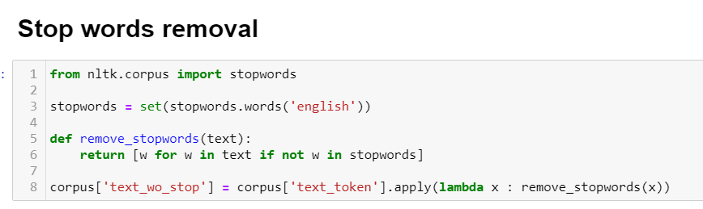
Data Cleaning
“In computing, stop words are words that are filtered out before or after the NLP text are processed. “ While “stop words” typically refers to the most common words in a language, it occur too frequently and not informative.

Slide 14
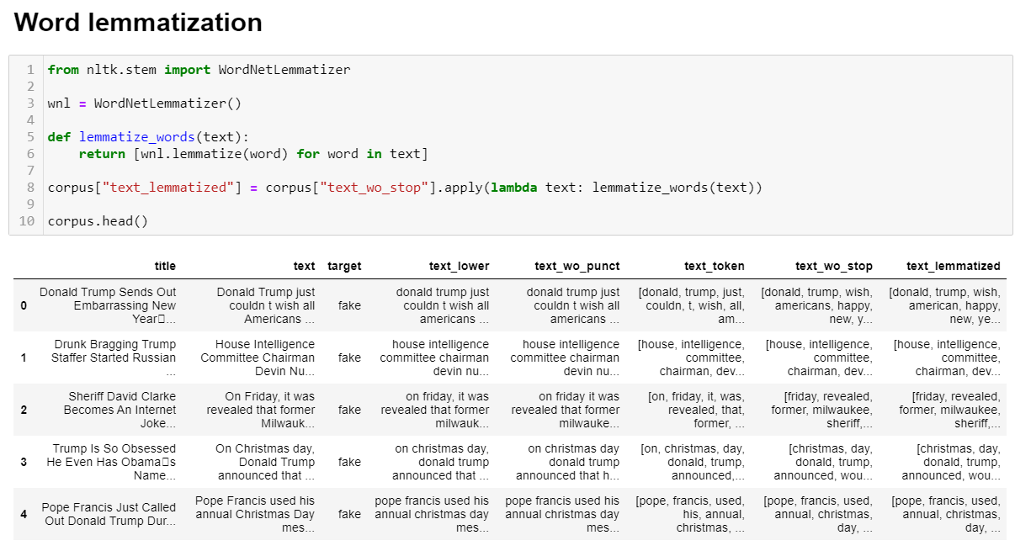
Data Cleaning
Convert the word in its Base from.

Slide 15
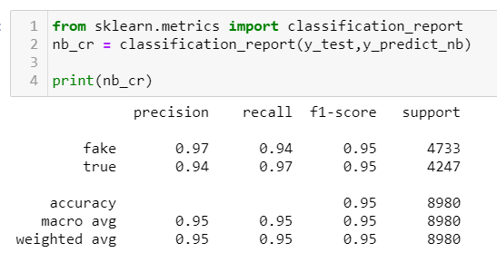
Classification Metrics
“ Confusion matrix : Basically this metrics how many results are correctly predicted and how many results are not correctly predicted.”
Accuracy score : Is the number of correct prediction over the total no. of predictions.

Slide 16
Classification Metrics
For this test dataset, the model perform well on unseen data, and the accuracy score is very good at 95%.

Slide 17
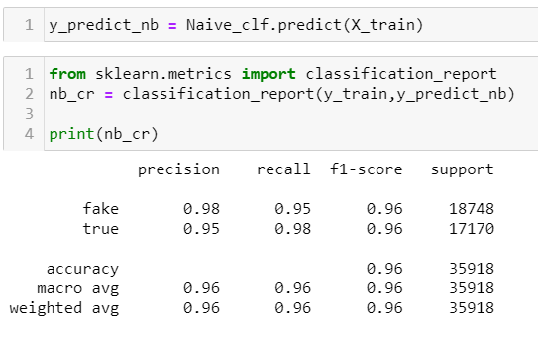
Classification Metrics
And we also have a very good score in training set at 96%.

Slide 18
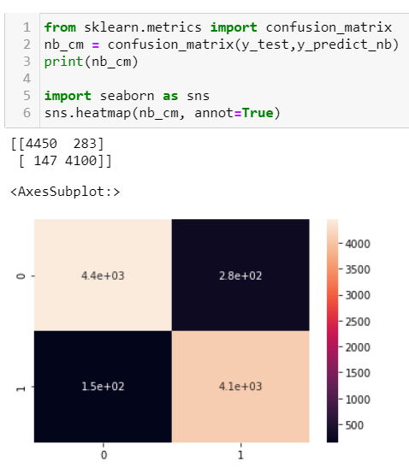
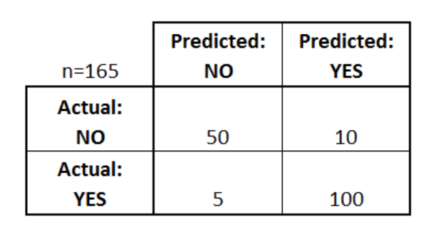
Confusion matrix:
A confusion matrix is a table that is often used to describe the performance of a classification model (or "classifier") on a set of test data for which the true values are known. The confusion matrix itself is relatively simple to understand, but the related terminology can be confusing.

Slide 19
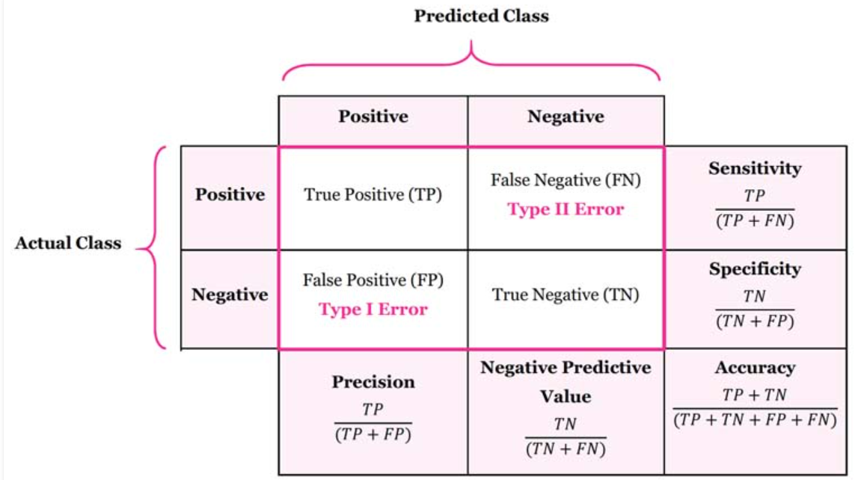
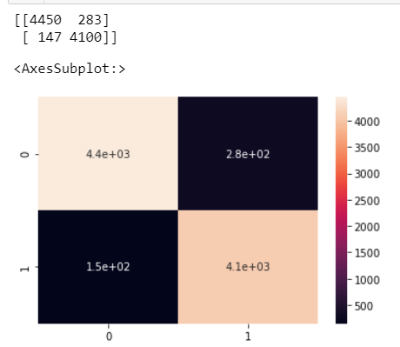
Confusion matrix:
Understanding the matrix
True Positive (TP) = is the number of correct prediction. Given data is fake and the classifier has been correctly predicted as fake.
False Negative (FN) = is the number of incorrect prediction. Given data is fake, however, the classifier has been incorrectly predicted as true
False positive (FP) = is the number of incorrect prediction. Given data is true, however, the classifier has been incorrectly predicted as fake.
True negative (TN) = the number of correct predictions. Given dataset is fake and the classifier has been correctly predicted as fake.

Slide 20
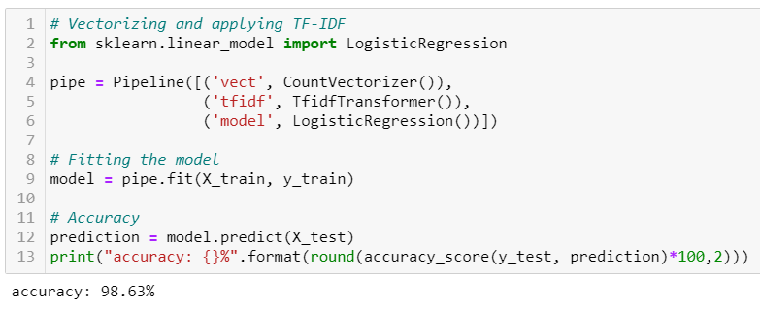
Model building
Logistic Regression
01
03

Slide 21
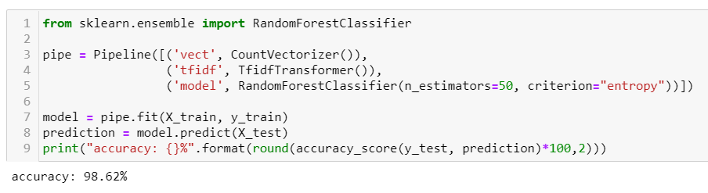
Model building
Random Forest Classifier
01
03

Slide 22
Thank you.

